Slide 1
Project Proposal
Review Phase #1
DAB103 – Section 4

Slide 2



Slide 3
Project Proposal
Phase#1

Slide 4
Course
Analytic Tools and Decision Making
Course Code
DAB 103
Section No.
004
Academic Term
Fall 2021
Professor
Mr. Sathish Chandra Pichika

Slide 5
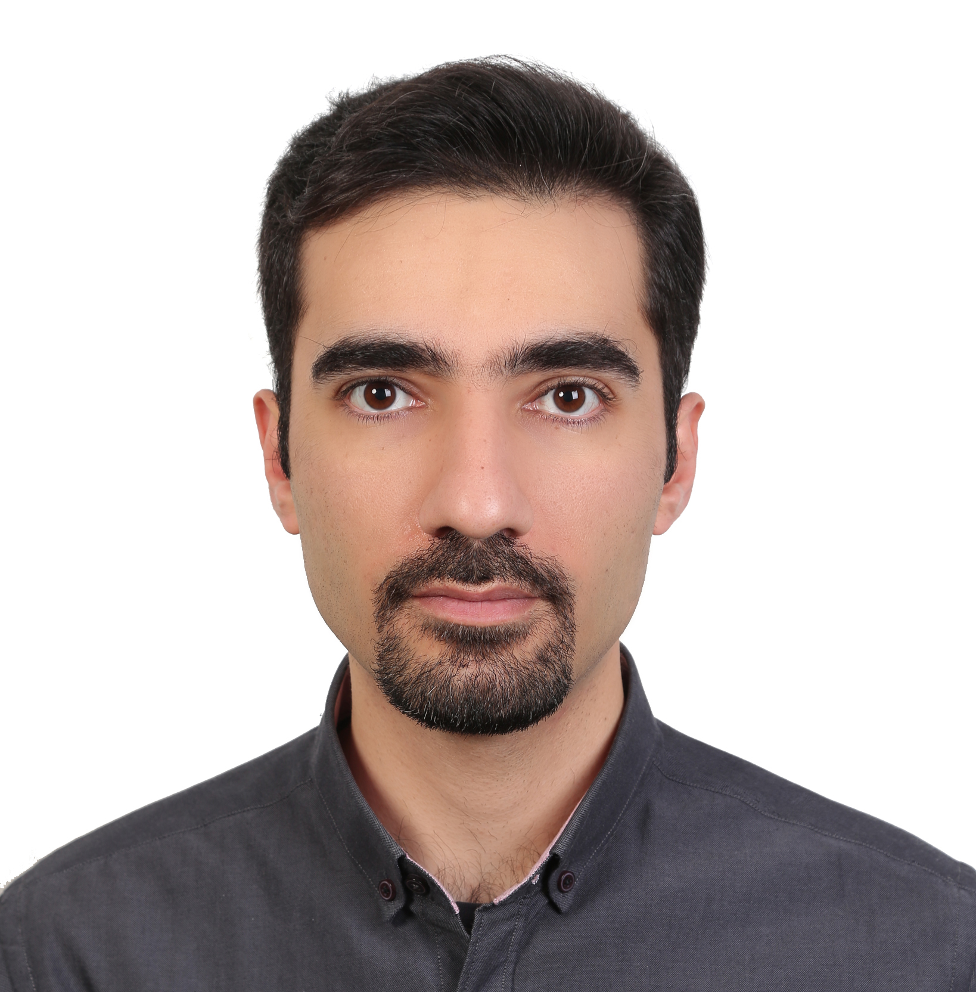

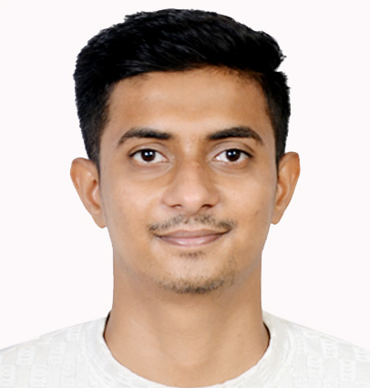
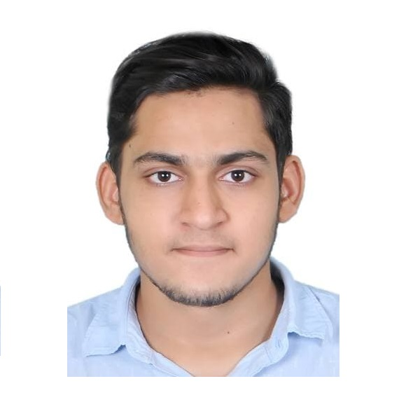
Team Introduction
Group Name
INSIGHT
Student ID
S. ID: 0780765
S. ID: 0780763
S. ID: 0783366
S. ID: 0795068
Name
Mohmad Faizal Mohmad Faruk Kazi
Muhammad Thanazal Kunduvalappil Mottammal
Farzin Valiloo
Maryam Aliakbari
Education Background
B.S. Computer Application
B.S. Computer Application
MBA
Industrial Eng.
Previous Experience
Marketing Manager
Biz. Development Manager
Student
Student

Slide 6
Dataset Description
- About Dataset
- Dataset Characteristic
- Other Works on this Dataset

Slide 7
About Dataset
Title
Bank Marketing Data
Source
Data.world
Dataset
https://data.world/data-society/bank-marketing-data
http://archive.ics.uci.edu/ml/datasets/Bank+Marketing
Data Link
https://query.data.world/s/lqrsaugj7kwkyazkvydowjuxjrybxx
Description
The data is related with direct marketing campaigns (phone calls) of a Portuguese banking institution.
Main Article
Moro et al., 2014, S. Moro, P. Cortez and P. Rita. A Data-Driven Approach to Predict the Success of Bank Telemarketing. Decision Support Systems, Elsevier, 62:22-31, June 2014

Slide 8

About Dataset
There are four datasets extracted from Main Dataset used in the article:
bank-additional-full.csv with all examples (41188) and 20 inputs, ordered by date (from May 2008 to November 2010), very close to the data analyzed in [Moro et al., 2014]
bank-additional.csv with 10% of the examples (4119), randomly selected from 1), and 20 inputs.
bank-full.csv with all examples and 17 inputs, ordered by date (older version of this dataset with less inputs).
bank.csv with 10% of the examples and 17 inputs, randomly selected from 3 (older version of this dataset with less inputs).
The smallest datasets are provided to test more computationally demanding machine learning algorithms (e.g., SVM).
The classification goal was to predict if the client will subscribe (yes/no) a term deposit (variable y).

Slide 9
Dataset Characteristic
The data is related with direct marketing campaigns of a Portuguese banking institution.
The marketing campaigns were based on phone calls.
Often, more than one contact to the same client was required, in order to access if the product (bank term deposit) would be ('yes') or not ('no') subscribed.
The data is example of data very close to the data analyzed in the main article ordered by date from May 2008 to November 2010.

Slide 10
Other Works on this Dataset
Classification
Predict Subscription
Machine Learning
: https://github.com/mcabinaya/Bank-Marketing-Data-Analysis
: https://medium.com/swlh/using-machine-learning-to-predict-subscription-to-bank-term-deposits-for-clients-with-python-aec8a4690807
: https://rpubs.com/alfandash/lbb-classification-2

Slide 11
Background & Motivation
Industry Knowledge domain
The Telemarketing Main Problems
Background & Motivation

Slide 12

Industry Knowledge domain
Telemarketing is the direct marketing of goods or services to potential customers over the telephone or the Internet.
Four common kinds of telemarketing include outbound calls, inbound calls, lead generation, and sales calls.
Notes:
https://www.investopedia.com/terms/t/telemarketing.asp#:~:text=Key%20Takeaways-,Telemarketing%20is%20the%20direct%20marketing%20of%20goods%20or%20services%20to,lead%20generation%2C%20and%20sales%20calls.

Slide 13

Industry Knowledge domain
Financial telemarketers convince consumers to switch banks or their stock trading account by making those necessary telemarketing calls.
Bank is one of the organization use telemarketing method for selling banking products or services.
Telemarketing is a popular method used by bank to selling, because bank products and services sometimes too complicated for some users to understand.

Slide 14


The Telemarketing Main Problems
As much as we are crazy for telemarketing, we cannot ignore the persistent problems facing it today!
Rejections
Increased costs
B2B marketers are getting rejected as more people have cynical whenever they receive a telemarketer
The Companies cannot initiate a cold calling campaign without churning out a hefty sum of money

Slide 15

Background & Motivation
A good telemarketing campaign plan clearly outlines the details and the scope of the campaign, so everyone is clear about what it involves and how it'll work.
Telemarketing campaigns can help you reach a group of targeted prospects or customers to communicate a message, gather feedback, and determine a next step for the relationship.
Background & Motivation

Slide 16
Problem Statement Project Proposal &
Problem Statement
Project Proposal
Project Audience
Short Problem Statement
Analysis Questions

Slide 17

Problem Statement
Marketing strategy could evolve over time. As the bank learn more about what is and what is not working, it will build a deeper understanding of the marketplace. Building an effective campaign strategy can help bank and its marketing department to create the better positioning for understanding the customers requirements.
Benefits of effective Marketing Campaigns
Attracts more sales
Improve the reputation of the bank
Improve Undertesting of the market & customers
Better long-term marketing campaigns

Slide 18

Project Proposal
The product of this project will be a descriptive analytics that examines the characteristics of a successful phone call for the purpose of direct marketing in terms of targeted prospect customers and properties of the call session, based on the data set.
The output of this project may help marketing managers in similar industries (e.g. finance, other service industries) to improve the performance of their direct marketing efforts by increasing the efficiency and effectiveness of the phone calls by exploring some of the aspects of successful direct marketing calls recorded in the dataset.
Proposal Statement

Slide 19

Project Audience
Audiences
Marketing Department
Medium & High-level Managers
Sales Department
Call Centers

Slide 20

Short Problem Statement
How to increase effectiveness of direct marketing campaign based on the dataset
Problem Statement

Slide 21

Analysis Questions
Who are the top targeted prospects in terms of successful outcome?
What is the best time to contact prospect customers?
What are the top characteristics of a successful call (duration and time)?
Question

Slide 22
Preliminary Exploratory Data Analysis (EDA)
Data Description
Univariant Preliminary Visualization: Numeric Variables
Univariant Preliminary Visualization: Categorical Variables
Future Exploration & Expected Transformation Steps

Slide 23
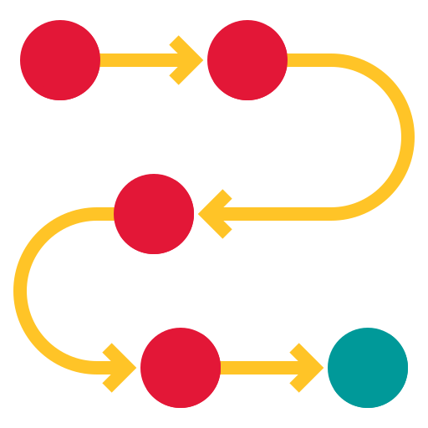
Preliminary EDA Steps
In this chapter, for the initial EDA:
The data types of variables will be explored
Each variable will be introduced
A plot and short description of each variable will be discussed.
A general exploration of correlation among numerical variables will be provided

Slide 24
Data Description
To describe and analyze the data, we need to understand the nature of data.
The type of statistical analysis is influenced by the type of data and can be performed on it.

Slide 25
DataFrame Structure
Primary Dataset Structure
No. Variables
21
Social and Economic context Attributes that have been Eliminated based on Problem statement
No. Rows
41188
Name | Description | Data Type
emp.var.rate | employment variation rate - quarterly indicator | Numeric
cons.price.idx | consumer price index - monthly indicator | Numeric
cons.conf.idx | consumer confidence index - monthly indicator | Numeric
euribor3m | euribor 3 month rate - daily indicator | Numeric
nr.employed | number of employees - quarterly indicator | Numeric
New-Structured Dataset
No. Variables
16
No. Rows
41188

Slide 26
Variables: Type & Description
Old Name | New Name | Data Type | Description
age | Age | Numeric | Client Age in Year
job | Job | Categorical | Client’s Job type (admin, bluecollar, housemaid, management, retired, self-employed, services, student, technician, unemployed, unknown)
marital | Marital | Categorical | Marital status (divorced (divorced or widowed), married , single, unknown)
education | Education | Categorical | Level of education (basic.4y, basic.6y, basic.9y, high.school, illiterate, professional.course, university.degree, unknown)
default | Credit | Categorical | Has the client credit in default? (no , yes, unknown)
housing | Housing_loan | Categorical | Has the client housing loan? (no , yes, unknown)
loan | Personal_loan | Categorical | Has the client personal loan? (no , yes, unknown)
contact | Call_type | Categorical | Type of contact communication (cellular, telephone)
month | Last_month | Categorical | Last contact month of year (jan, feb, mar, apr, .., nov, dec)
day_of_week | Last_weekday | Categorical | Last contact day of the week (mon, tue, wed, thu, fri)
duration | LastCall_Dur | Numeric | Last contact duration, in seconds. The duration is not known before a call is performed. (if LastCall_Dur=0 then y='no')
campaign | NewCampaign_CallNo | Numeric | Number of contacts performed during this campaign and for this client
pdays | Campaign_Intervals_Day | Numeric | Number of days passed by after the client was last contacted from a previous campaign
previous | PrevCampaign_CallNo | Numeric | Number of contacts performed before this campaign and for this client
poutcome | PrevCampaign_Result | Categorical | Outcome of the previous marketing campaign (failure, nonexistent, success)
y | Campaign_Success | Categorical | Has the client subscribed a term deposit? (binary: yes , no)

Slide 27

Data Type
Categorical
Numerical
Job
Education
Age
Marital
Credit
LastCall_Dur
Personal_loan
Housing_loan
NewCampaign_CallNo
Last_month
Last_weekday
PrevCampaign_CallNo
PrevCampaign_Result
Call_type
Campaign_Intervals_Day
Campaign_Success

Slide 28
Missing & Unknown Values
“Unknown” Values
Missing Values
0
Job
330
% 0.8
Marital
80
% 0.19
Education
1731
% 4.2
Credit
8597
% 20.9
Housing_Loan
990
% 2.4
Personal_Loan
990
% 2.4

Slide 29
Univariant Preliminary Visualization
Numeric Variables

Slide 30
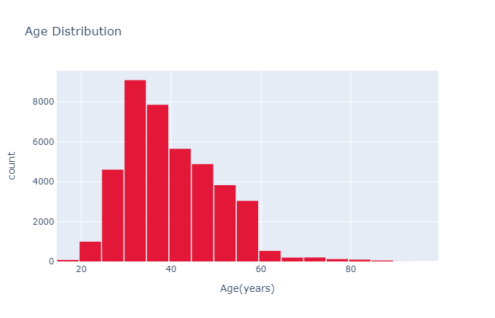
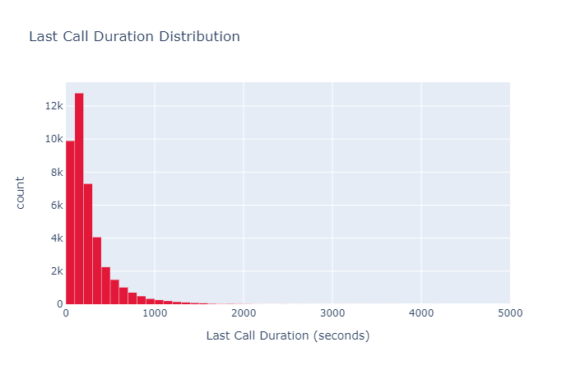
Preliminary Visualization: Numeric Variables
Age
LastCall_Dur
The data for age variable is between 15 and 98 and more than 50% of the clients are younger than 40 years old.
More than 30% of the call durations fall between 100 and 200 seconds. There maybe some outlier data in this variable.
Mean
Median
Var
Distinct No
Skew
Mean
Median
Var
Distinct No
Skew
40.02
38
108.6
78
Right
258.3
180
259.3
1544
Right

Slide 31
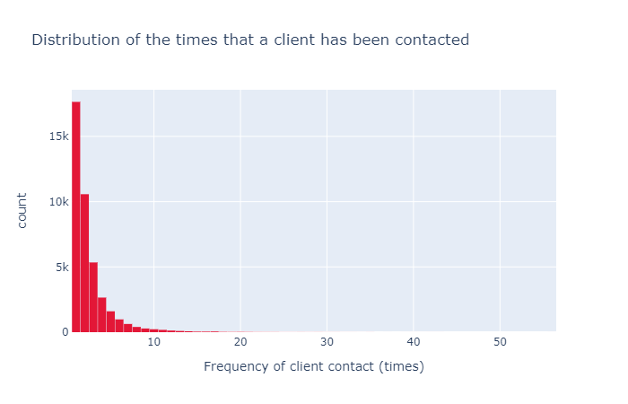
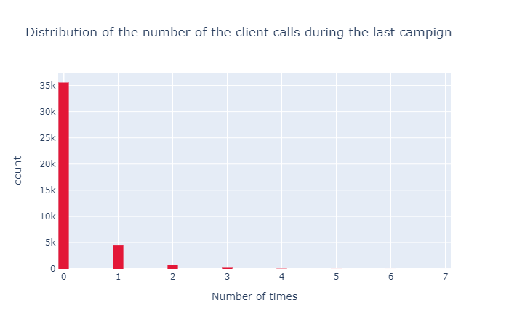
Preliminary Visualization: Numeric Variables
NewCampaign_CallNo
PrevCampaign_CallNo
This variable is highly skewed and almost 70% of the observations were under 2. It has a long tail, and it has possible a few outlier data.
This plot shows that most of the clients has not been included in the previous campaign (about 85%).
Mean
Median
Var
Distinct No
Skew
Mean
Median
Var
Distinct No
Skew
2.56
2
7.67
42
Right
0.17
0
0.25
8
Right

Slide 32
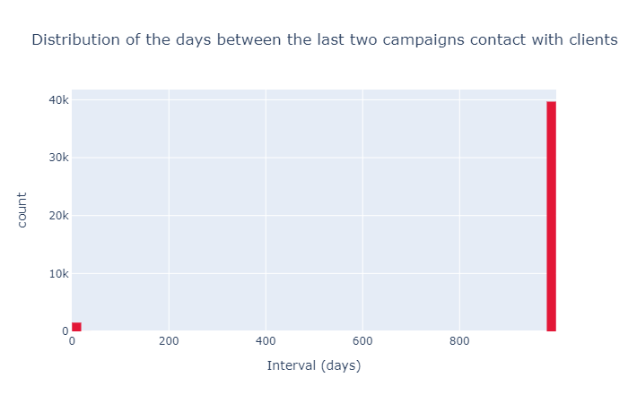
Preliminary Visualization: Numeric Variables
Campaign_Intervals_Day
This plot is consistent with the previous plot and shows that most of the clients have not been contacted during the previous campaign.
Mean
Median
Var
Distinct No
Skew
962.4
999
186.911
27
Left

Slide 33
Univariate Preliminary Visualization
Categorical Variables

Slide 34
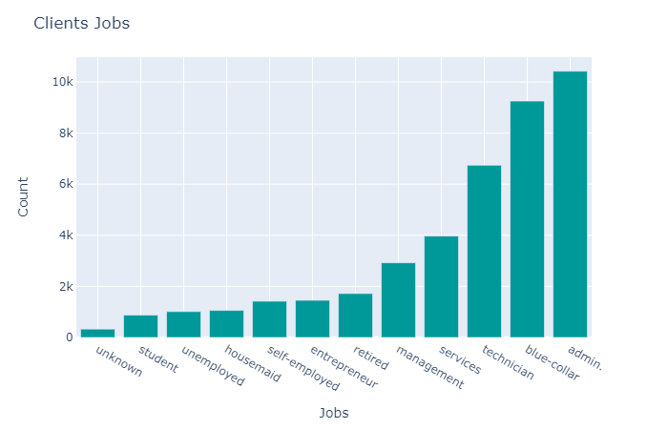
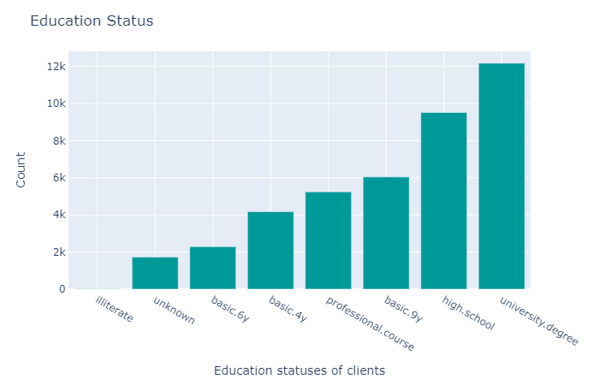
Preliminary Visualization: Categorical Variables
Job
Education
About half of the phone calls are made with clients that either have administrative roles or are blue-collar workers.
About 50% of the clients in this campaign have at least high-school level education. Education level of about 4% is unknown.
Distinct No
Distinct No
12
8

Slide 35
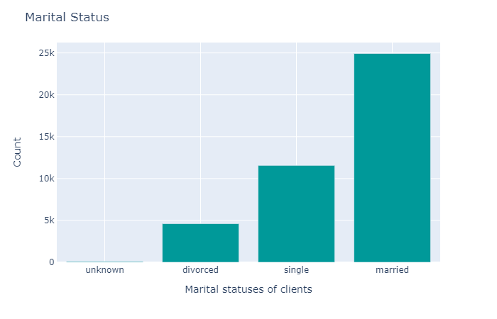
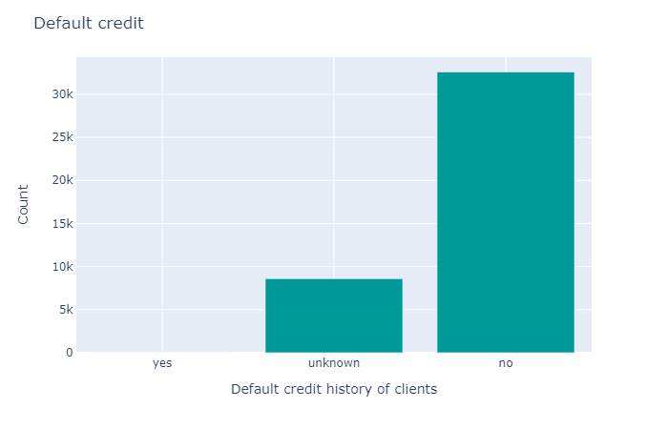
Preliminary Visualization: Categorical Variables
Marital
Credit
About 60% of the correspondents are married. Comparison of this data with the age group may have interesting outcomes.
Only 3 correspondents have default credits. The status of about 20% of the clients is unknown.
Distinct No
Distinct No
4
3

Slide 36
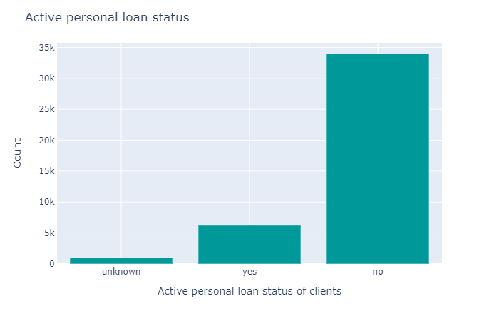
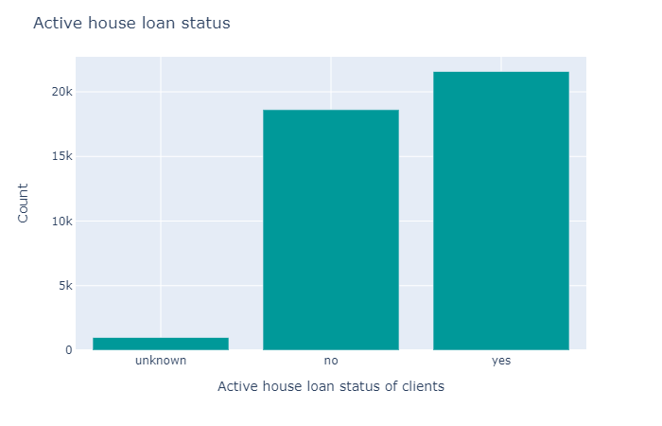
Preliminary Visualization: Categorical Variables
Personal_loan
Housing_loan
More than 80% percent of the correspondents have no personal loans.
More than 50% of the correspondents have some kind of housing loans.
Distinct No
Distinct No
3
3

Slide 37
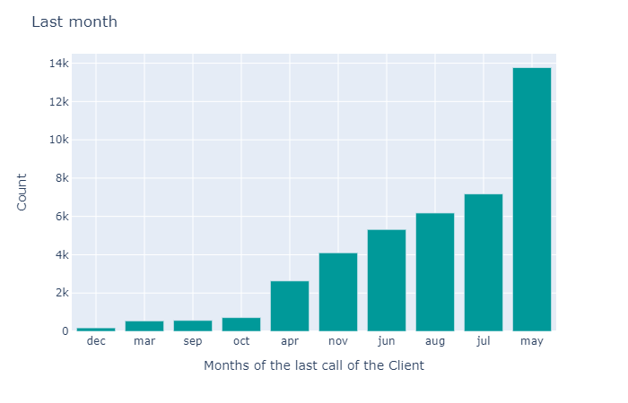
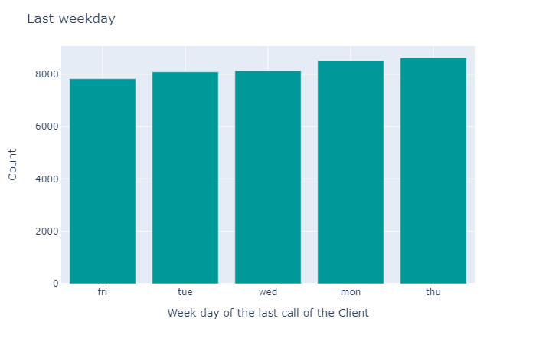
Preliminary Visualization: Categorical Variables
Last_month
Last_weekday
No calls were made during January and February. Most of the calls were made during May (approx. 34%).
It seems that the calls were made in balance regarding the day of the week that calls were made.
Distinct No
Distinct No
10
5

Slide 38
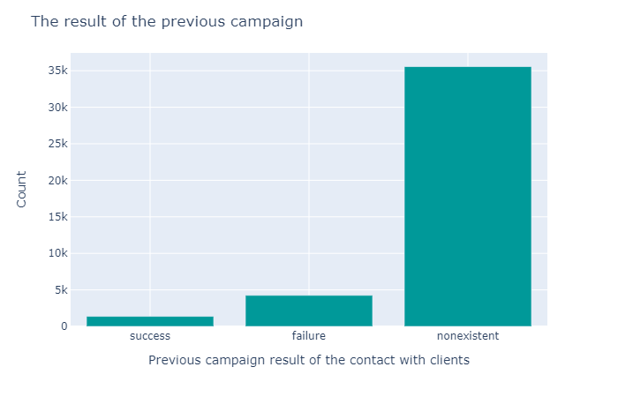
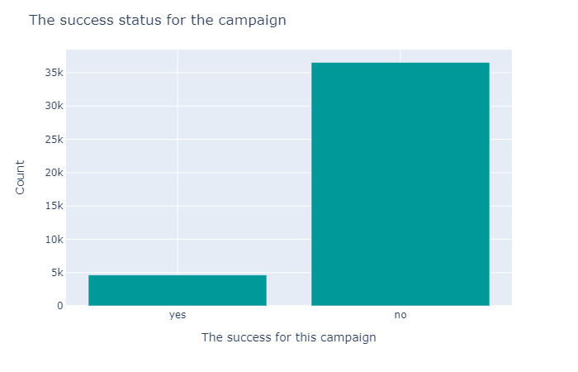
Preliminary Visualization: Categorical Variables
PrevCampaign_Result
Campaign_Success
It seems majority of the correspondents are selected from clients that have not been targeted during previous campaigns (87%).
The rate of success (signing up to deposit into a special account) in this campaign was 11.2%
Distinct No
Distinct No
3
2

Slide 39
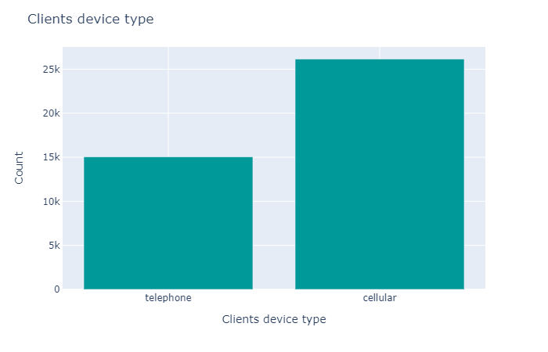
Preliminary Visualization: Categorical Variables
PrevCampaign_Result
Call_type
It seems majority of the correspondents are selected from clients that have not been targeted during previous campaigns (87%).
Most of the correspondents were contacted via their cellphones rather than their telephones (63.5% vs. 36.5%).
Distinct No
Distinct No
3
2

Slide 40
Preliminary Visualization: Categorical Variables
Campaign_Success
The rate of success (signing up to deposit into a special account) in this campaign was 11.2%
Distinct No
2

Slide 41
Correlations
- Pearson correlation matrix

Slide 42
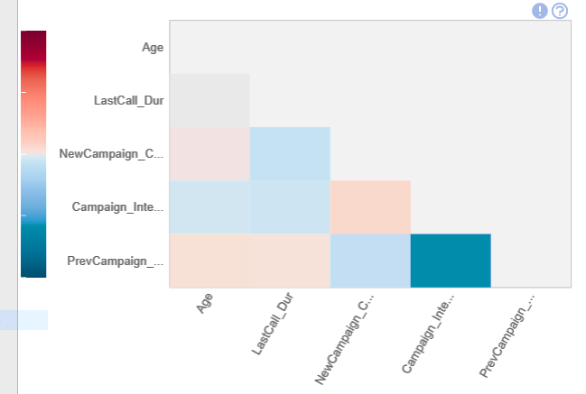
Pearson correlation matrix (by dataprep.eda)
Cor. Method | Pearson | Spearman | KendallTau
Highest Positive Correlation | 0.053 | 0.056 | 0.05
Highest Negative Correlation | -0.588 | -0.51 | -0.5
Lowest Correlation | 0.001 | 0.001 | 0.001
Mean Correlation | -0.058 | -0.054 | -0.05
In a general view of the correlation matrix of a subset of the dataset (only the numerical variables are included in this subset), it seems only “PrevCampaign_CallNo” and “Campaign_Intervals_Day” have a considerable negative correlation. This correlation is somewhat expected due to the nature of these variables. More thorough analysis is needed to determine other possible correlations.

Slide 43
Code & Repository Address
- The link of Codes provided in this phase

Slide 44

Code repository Link
The project code could be find in GitHub code repository:
Path: Frz2005> DAB103 > main branch > P1v1.py
link: https://github.com/frz2005/DAB103

Slide 45
Future Exploration & Transformation steps

Slide 46

Future Exploration & Transformation steps
Based on the initial exploration done in this phase these future analysis should be done in this project:
Determination of outlier data
Cleaning the data set
Normalizing variables using appropriate methods
Additional exploration of correlations
Exploring pair correlations
Including categorical variables in correlations

Slide 47
Resources
https://www.investopedia.com/terms/t/telemarketing.asp#:~:text=Key%20Takeaways-,Telemarketing%20is%20the%20direct%20marketing%20of%20goods%20or%20services%20to,lead%20generation%2C%20and%20sales%20calls
https://data.world/data-society/bank-marketing-data
https://qlutch.com/telemarketing/create-a-plan-for-a-telemarketing-campaign
https://archive.ics.uci.edu/ml/datasets/Bank+Marketing

Slide 49
File & Charts Theme
Title Font : Verdana
Body Font: Calibri Light / Calibri
Priority
Color
HEX
RGB
1
#44546A
(68, 84, 106)
2
#E31737
(227, 23, 55)
3
#8497B0
(132, 151, 176)
4
#FFC427
(255, 196, 39)
5`
#009999
(0, 153, 153)
6
# 0070C0
(0, 112, 192)

